Slide 1
Hotel Automation System
(Hotel Paradise)
SE Final-Evaluation
Group-9
Assigned by :- Prof Jayprakash Lalchandani
Mentor :- Mahir shah

Slide 2
Group Members:
Nakul Patel – 201901043
Shrey Mavani – 201901224
Divyesh Patel – 201901259
Soham Patel - 201901274

Slide 3
Functional Summary
Customer:
Can book/cancel room online from website.
Can order food online from their room using website.
Can even book taxi services and other service provided by the hotel.
Different payment options will be provided to the customer for the payment.
Can search and be navigated by the website inside the hotel.
Extra discount will be given to the regular customers.

Slide 4

Staff
Can book rooms.(from reception table) Can be able to check credentials of arriving customer. Can update room status onto database.
Can generate bill and collect payment.
Manager
View statistical data of all rooms booked according to filtered month and year.
Can view information of guest, staff member, rooms and even can change prices.
Can give access to receptionist for viewing and editing current rooms booked.
Can edit the food menu and give access to catering manager for editing also.

Slide 5
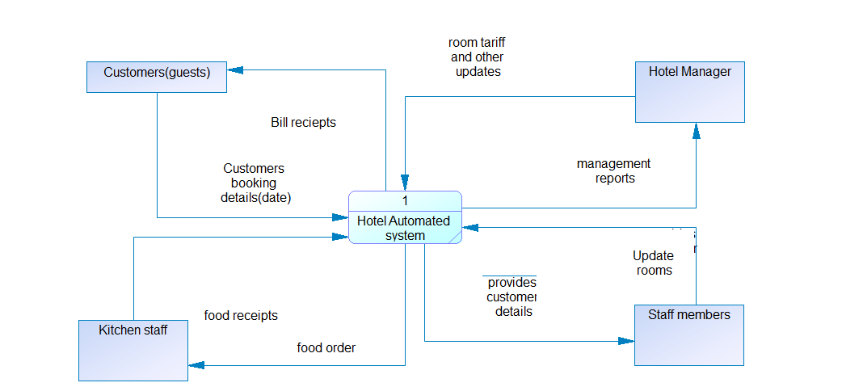
Context diagram(DFD-0)

Slide 6
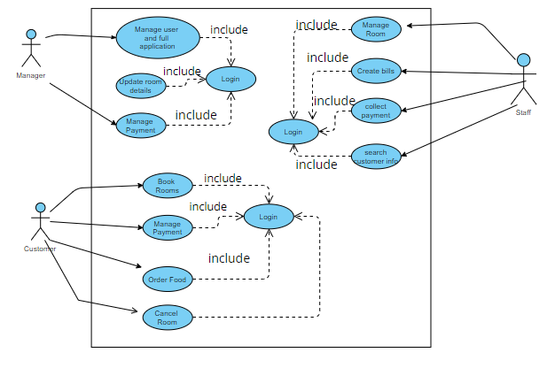
Top Level Use Case Diagram

Slide 7
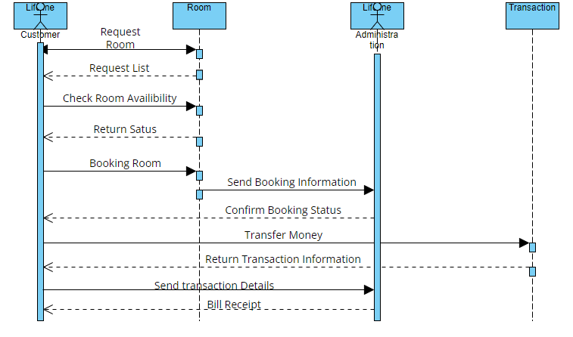
Sequence Diagram

Slide 8
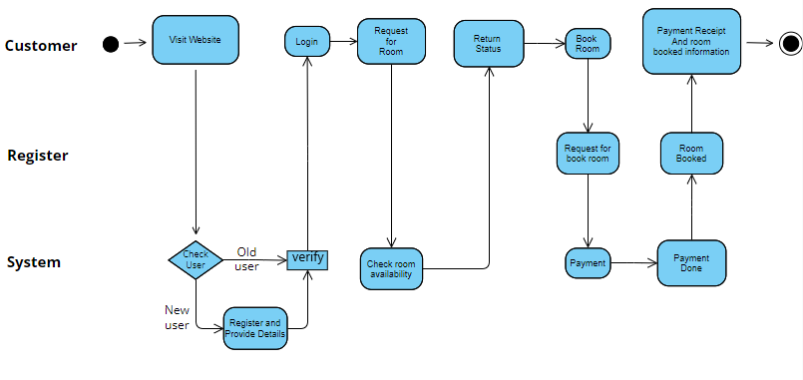
Activity Diagram

Slide 9
Tools and Technologies
Technologies:
HTML
CSS
Java-Script
PHP
RDBMS
Cloud services
Tools:
Notepad++ and VScode
PostgreSQL (for database)
Xampp (to connect database)
Azure App Service (for deployment of website) or Heroku

Slide 10
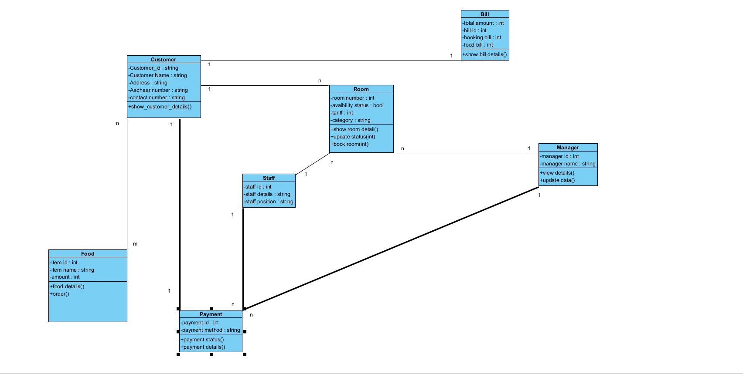
Class Diagram

Slide 11
Summary of Implementation
Software | Version
PHP | 7.4.12
JavaScript | ECMAScript 5(1.8.5)
MySQL | 8.0.19
Xammp | 8.1.5

Slide 12
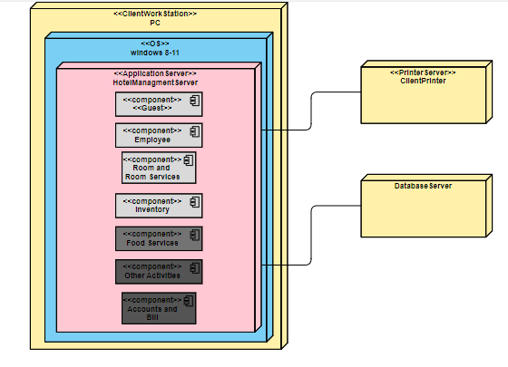
Deployment Diagram

Slide 13
Memberwise Contribution
Name | Contribution
Nakul | Finalize the functionalities according to users. Decide the interface for customers and add few more functionalities and features. Structural and behavioural diagrams. Create database for storing and managing data like customer login info, bill info. Added different functionalities and web page design of the login page. Review and test the website’s login page.
Shrey | Finalize the parameters for data storage and authentication. Decide interface for staff members and helps in reading background information. Structural and behavioural diagrams. Start making the main/login webpage and connect to related database. Added functionalities of manager in the respective page. Review and test the manager page.

Slide 14
Divyesh | Decides software needed for making website and database and to connect them. Decide the interface for staff members and helps in documentations. Structural and behavioral diagrams. Create database for storing and managing data like manager, and staff details, etc. Added functionalities of staff in the respective page. Review and test the staff’s page.
Soham | Decides the flow of website according to functionalities. Decide the interface for manager and separate user stories from requirements. Structural and behavioural diagrams. Start making the main/login webpage and connect to related database. Added functionalities of customer in the respective page. Review and test the customer’s page.

Slide 15
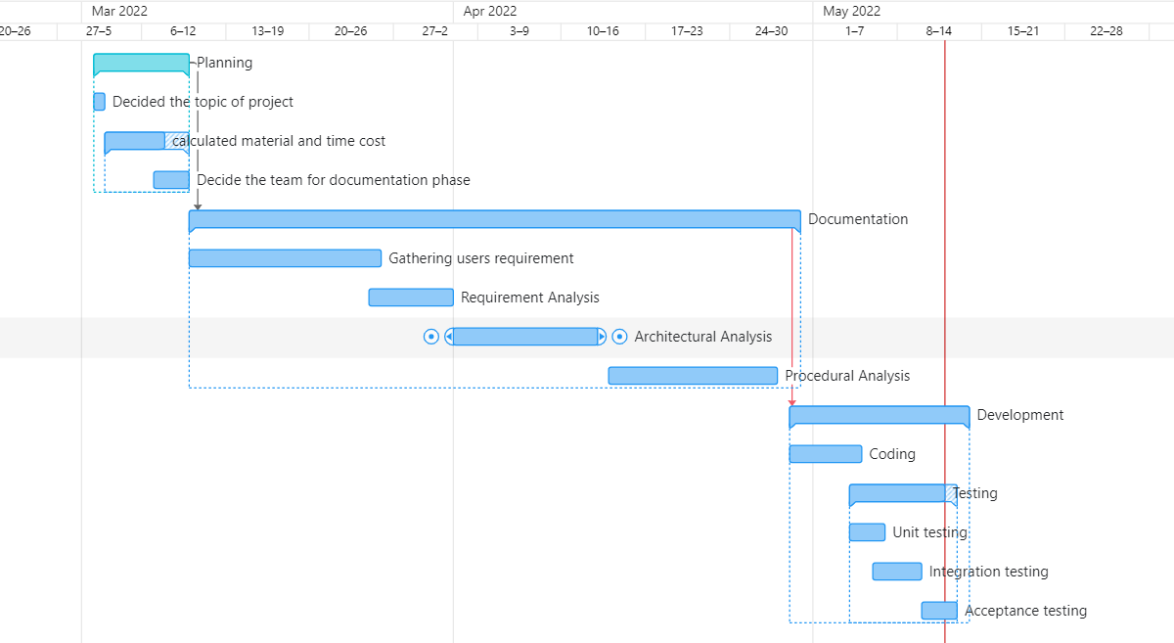
Gantt Chart for entire project

Slide 16
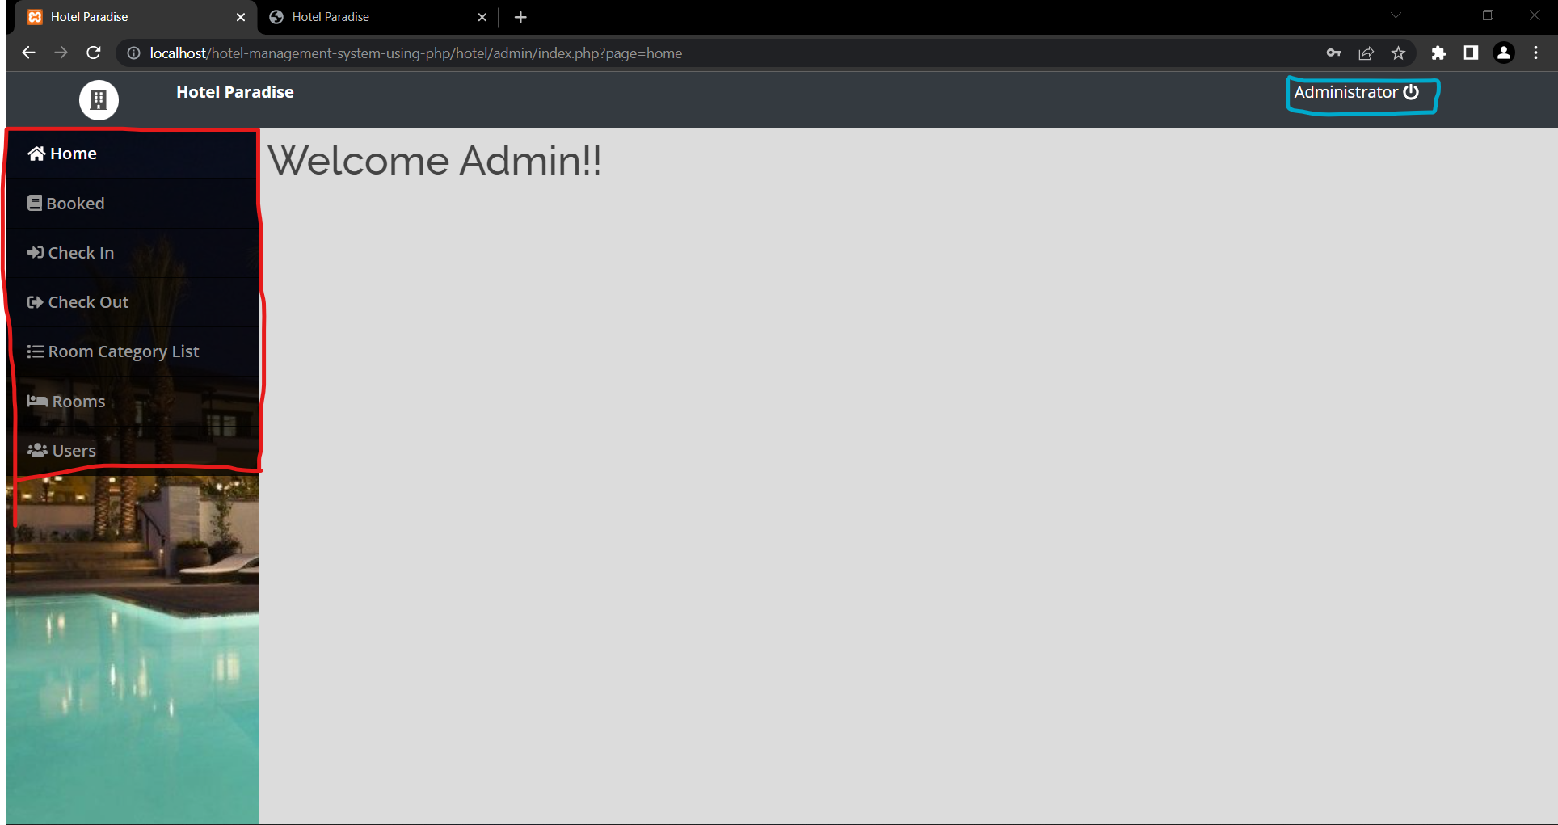
UI/UX Navigation
So, this is the admin/manager page, and after logging in it he can avail features available on the left panel of page[red box].
He can logout from this page from the button provided in the top panel[blue box].
Redirection from one functional page to another can be done.
By clicking on the features the manager will be redirected to perform that function:
1. Booked : booked room details
2. Check in : Guest who are currently checked in
3. Check out : Guest who have checked out and are currently checked in
4. Room category list : List of room with their details
5. Rooms : Room wise details
6. Users : Details of admin users

Slide 17
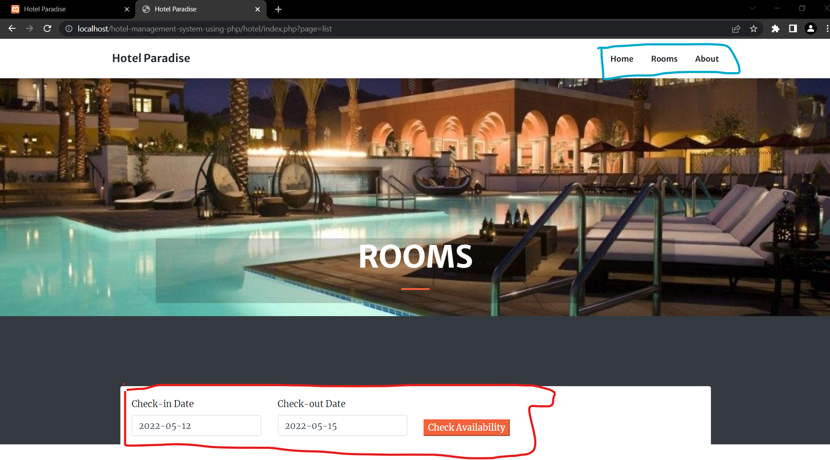
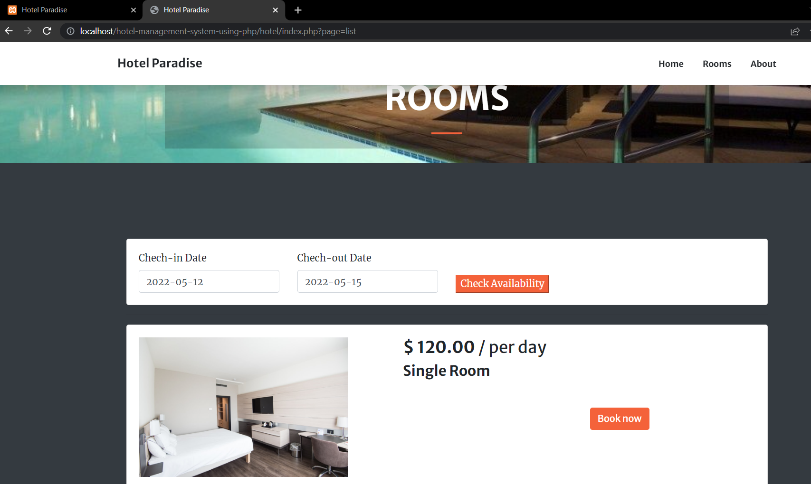
The first image is home page for users/guest and second is for room booking. We can redirect from one to another using options in above options in top bar of webpage. Even there is last page containing details of our group.

Slide 18
Summary of Test Plan Unit Test
Test | Use Case Derivation | Test Result
Generate hotel occupancy report | Report use case | Passed
Add new Customer | User profile use case | Passed
Find a room | hotel Use case | Passed
Make Reservation | Make Reservation use case | Passed
Cancel Reservation | Make Reservation use case | Passed
Generate Bill | Make Payment use case | Passed
Make payment at check out | Check Out Use Case | Passed

Slide 19
Integration Test
Test | Use Case Description | Test Result
Make reservation, check in and check out as per reservation | Reservation use case, check in use case, Check out use case | Passed
Manager View Report on hotel occupancy | Generate use case | Passed
Manager check room availability | Room use case | Passed
View customer record | Customer record use case | Passed

Slide 20
GitHub Link
https://github.com/nakul3736/SE_Project

Slide 21
Thank you!

